Slide 1
SHRI DEVI INSTITUTE OF ENGENEERING AND
TECHNOLOGY
PROJECT PRESENTATION
BOOK ORDERING
CHAITHRA P
1SV21CS018
CSE ‘5th Sem’

Slide 2
LIST OF CONTENTS
Introduction
What is Online Book Store
Objectives
Requirements
Working of Projects
Screenshots of our webpage
Conclusion

Slide 3

INTRODUCTION
Pentagon space is one of the training company dedicated to address for upskilling the existing professionals in the companies
It provide a course on various technologies such
as java full stack , software testing etc.

Slide 4

MERN stands for MongoDB , Express , React , Node , after the four key technologies that make up the stack that is used for easier and faster deployment of full-stack web application
MongoDB – document database
Express(.js) – Node.js web framework and web
application
React(.js) – a client-side JavaScript library
Node(.js) – the premier JavaScript web server

Slide 5
WHAT IS ONLINE BOOK STORE
Online Book store is an online web application where the customer can purchase book online.
Through the web browser the customers can search the book by its Title and later they can add it to the shopping cart and finally they can purchase books.
The online Book Store application enables vendor to setup online book store , customer to browse through the books and system administrator to approve and reject request for new books and maintain lists of book categories.

Slide 6
OBJECTIVES
The main objective of the “Online book store” is to provide an essence of online book store via a simple and yet power full medium.
The Project’s main goal is to develop an online book store where users can search for and make purchases based on title , author , and subject.
We aim to create a user-friendly interface that ensures a hassle-free browsing experience, secure transactions, and timely delivery of books.

Slide 7
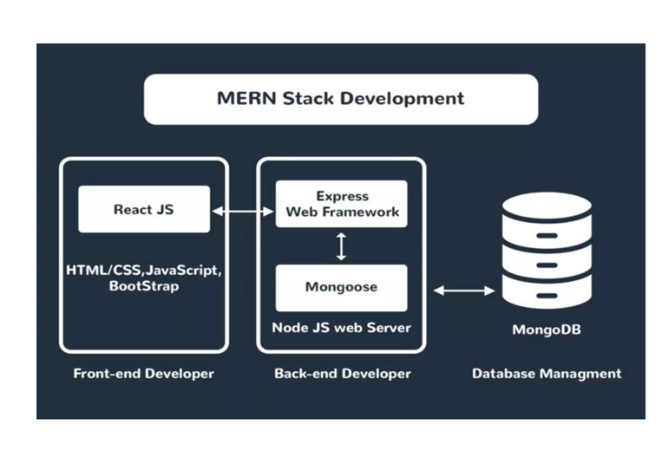
REQUIREMENTS
Hardware requirements
i. Server Hardware-Node js
ii. Database Server-MangoDB
Software Requirements
i. Frontend(client side)-Reactjs
ii. Backend(Server side)-Node js, Express js
iii. API(Application Programming Interface)

Slide 8
WORKING OF PROJECT
The user entering the website for ordering the book.
They are asked to register for the webpage and login to that page.
If the user as been already registered to the page they can directly login to that page.
After login , they can select the required books in the home page.
In the shop page they can search for the book based on their categories.
After selecting the book they should add it to the cart and they can increase the number of copies.
User can place the order successfully.

Slide 9
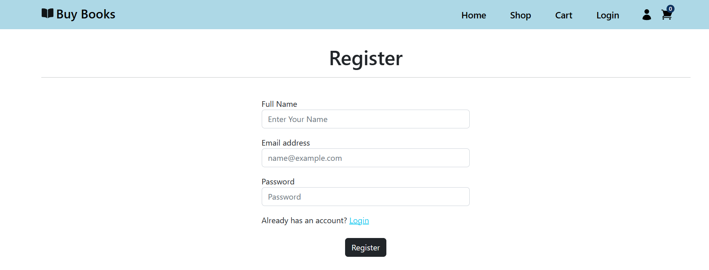
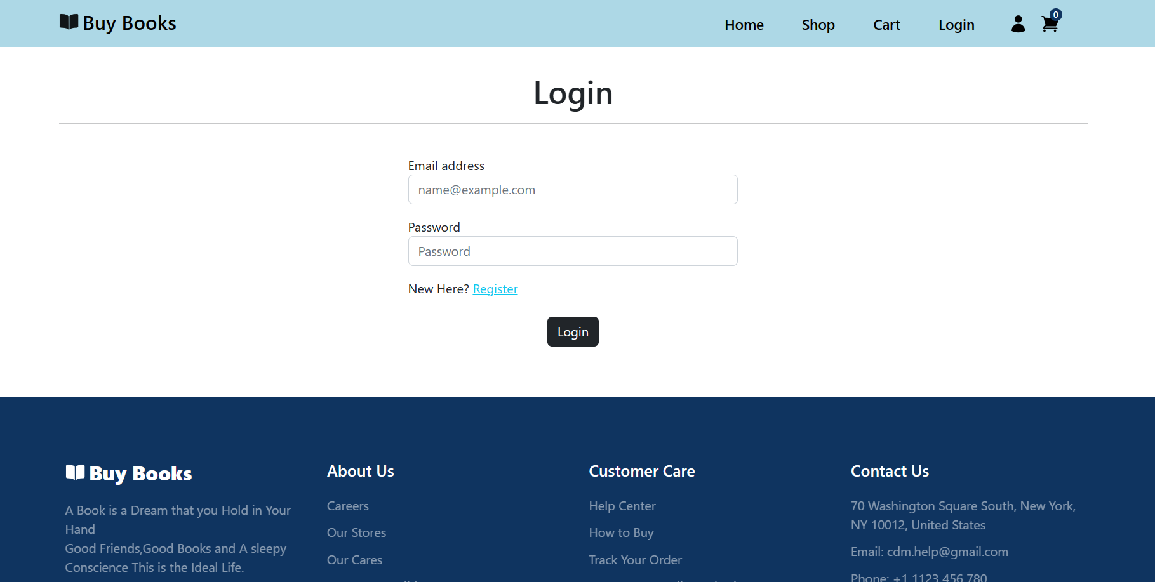
SCREENSHOTS OF OUR WEBPAGE

Slide 10
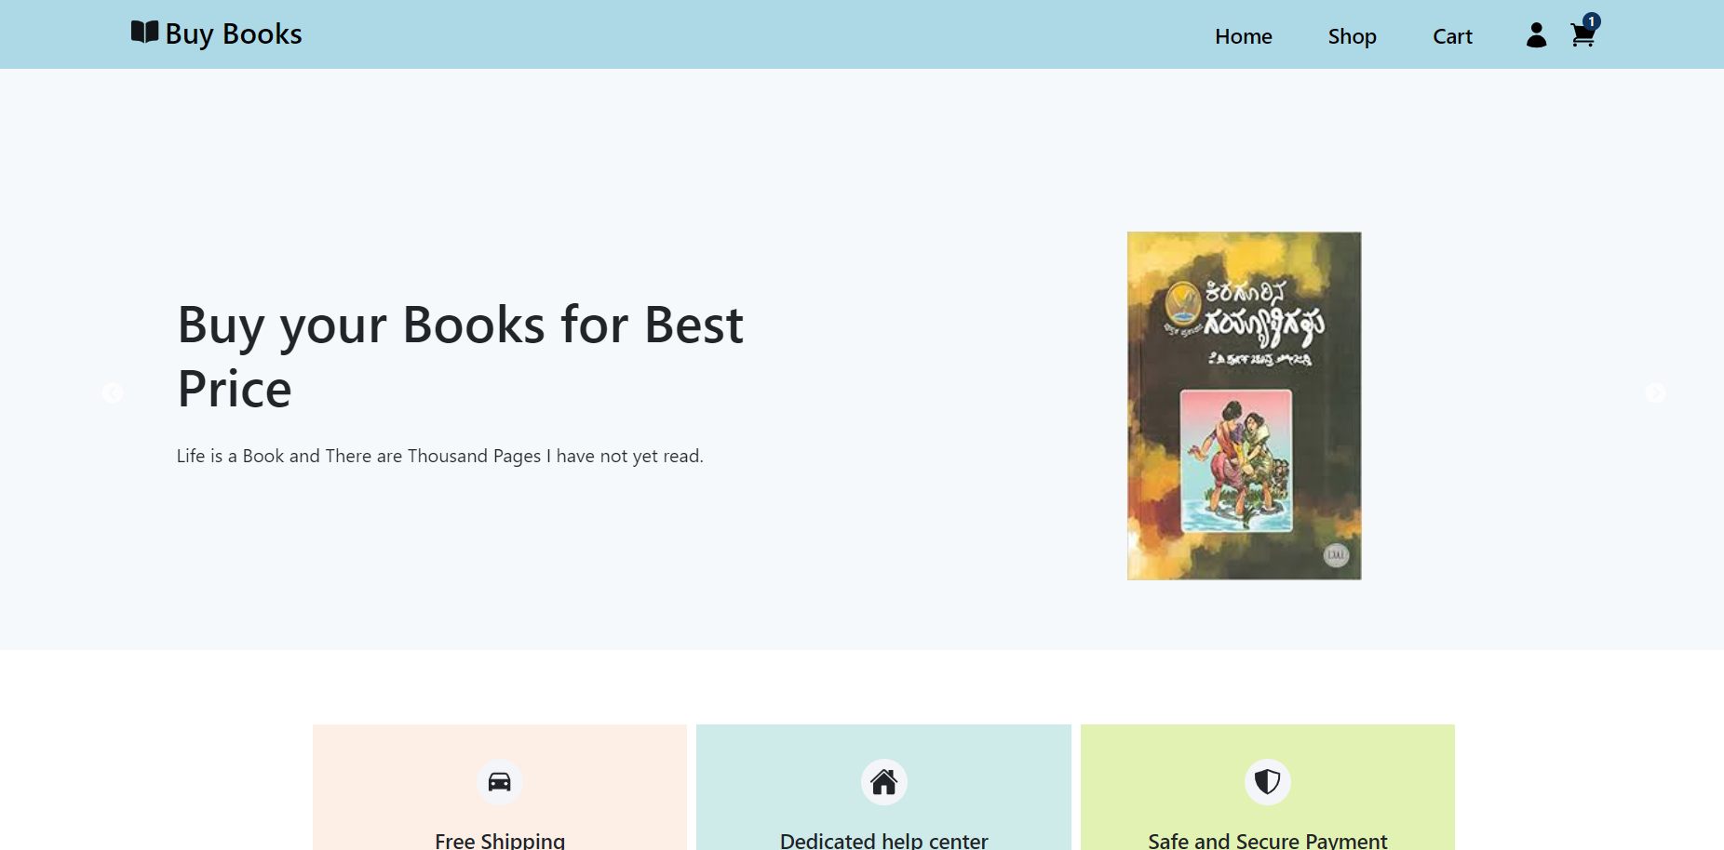
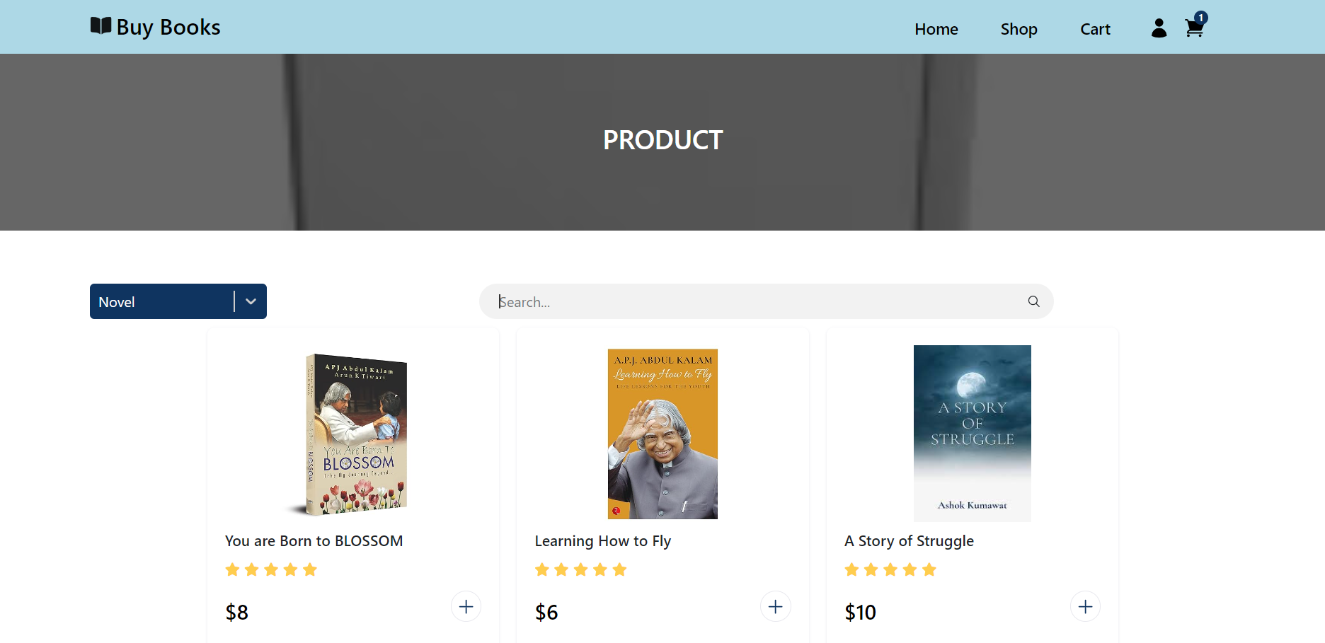

Slide 11
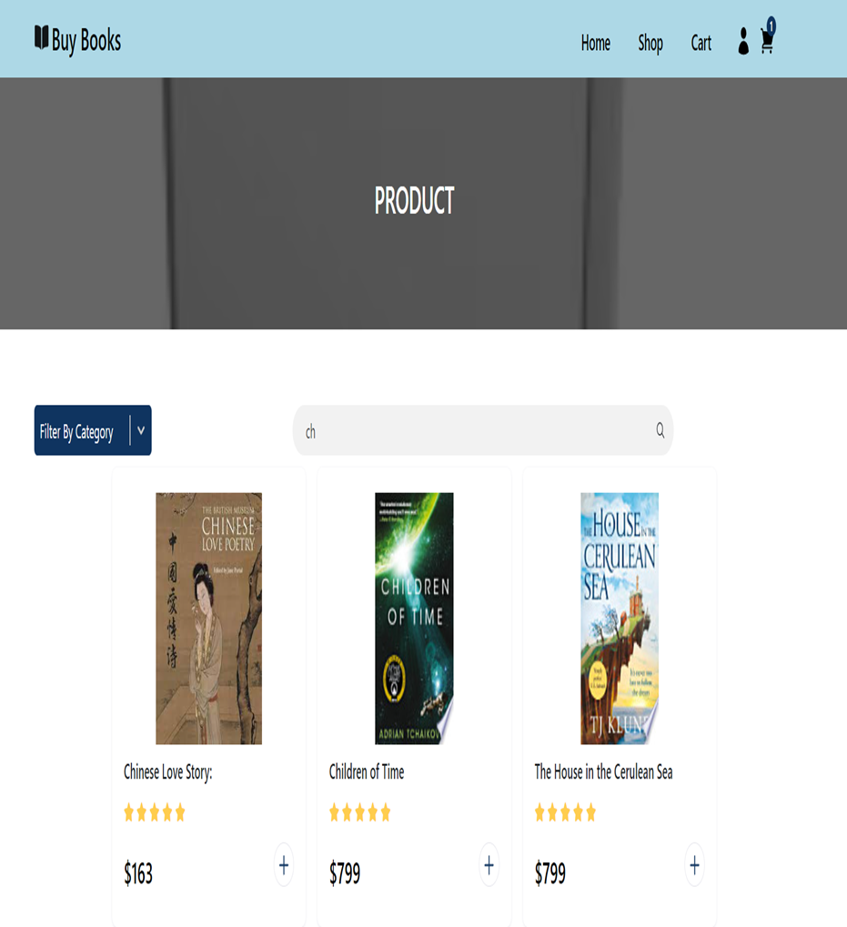
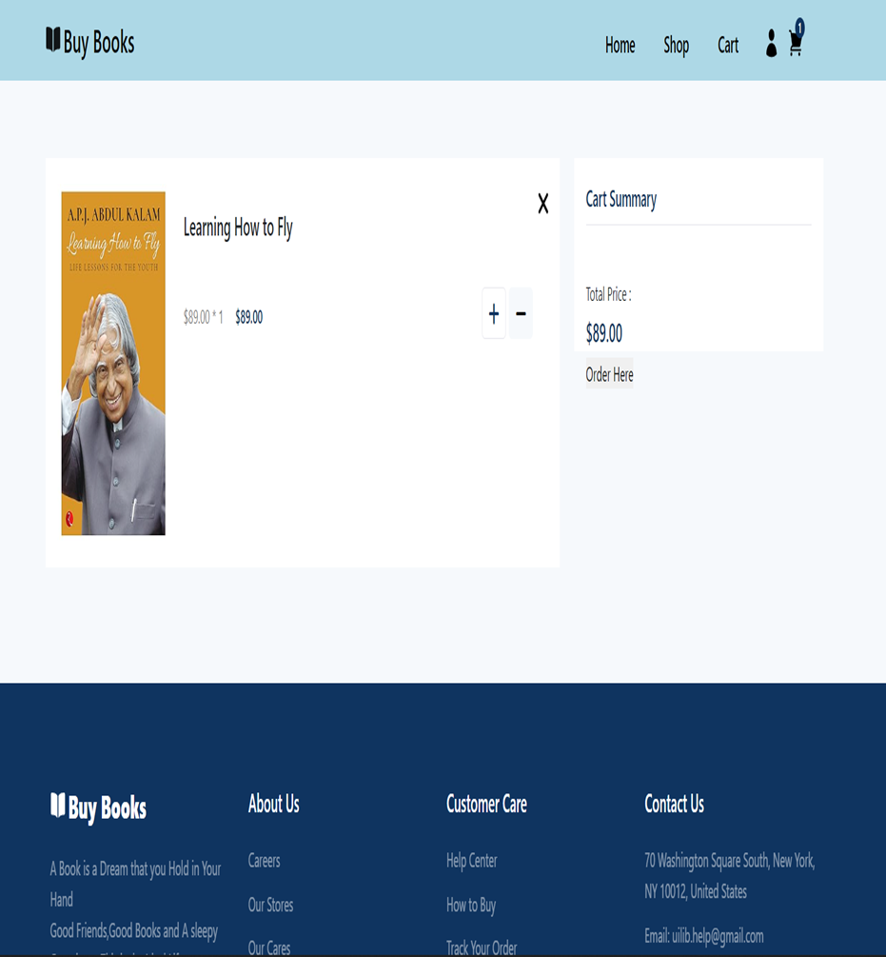

Slide 12
CONCLUSION
The book ordering project provides a seamless and secure platform for users to explore, select, and purchase books.
The well-designed user interface ensures a positive experience, from registration to checkout. With features like a comprehensive book catalog, intuitive shopping cart, and efficient order management, the system meets the needs of both customers and administrators.

Slide 13


